Slide 1
Dual Fuel S-100 Part 7 Proposal
S-100 Part 7 currently contains a description of the geometry model. This is mostly derived from
ISO19107
S-57 (Main document and Appendix B1)
How it should work?
S-100 imports and “profiles” ISO191XX describing how it implements the parts it is “interested in”
Product specifications implement the “level” of geometry they require
No need for ISO topology

Slide 2
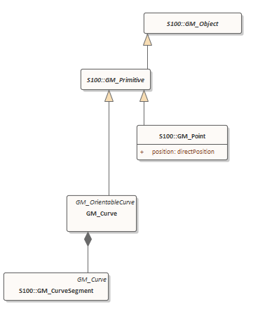
But…
In specifying geometry tests for the S-100 enabled S-58….
The levels are incremental and the ISO19107 model isn’t
The mapping of levels to ISO isn’t explicit. A few adjustments need to be made to make it clear
And some clarifying edits to Part 7’s definitions of levels.
Should make allowable geometry explicit and completely machine readable/validatable
A few areas still to be defined
Should feature catalogues state what level of geometry they require/support
GML vs ISO8211 support

